Slide 1

Beta Brotherhood Assessment
Chapter Report Overview

Slide 2
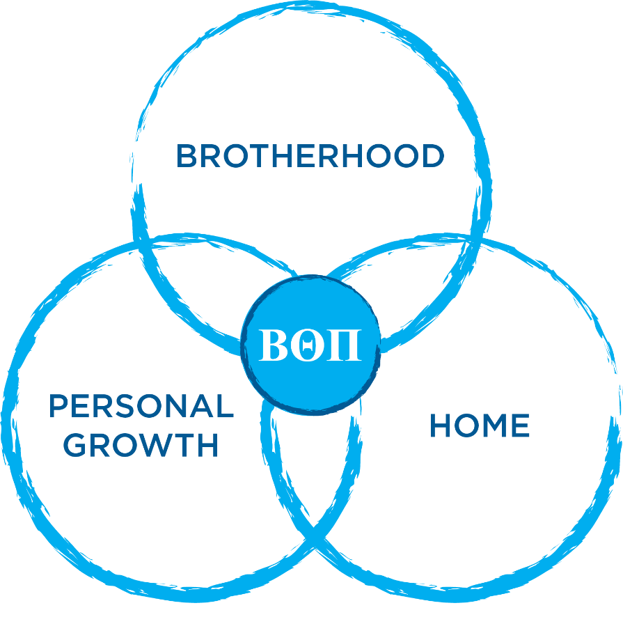
Strategic Initiatives
Beta Theta Pi Fraternity
SIX STRATEGIC INITIATIVES
Cultural Assessment
Volunteer Engagement
Housing Standards
Risk Management Education
Member Education
Interfraternal Partnerships

Slide 3


Slide 4
Assessment Response Rate
134
84%
48
Chapters
Organizational Response Rate
Chapters with 100% response rate

Slide 5
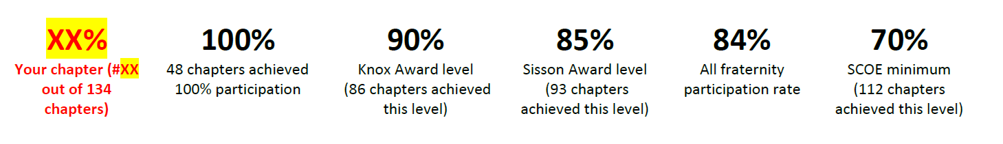
The Chapter Report

Slide 6
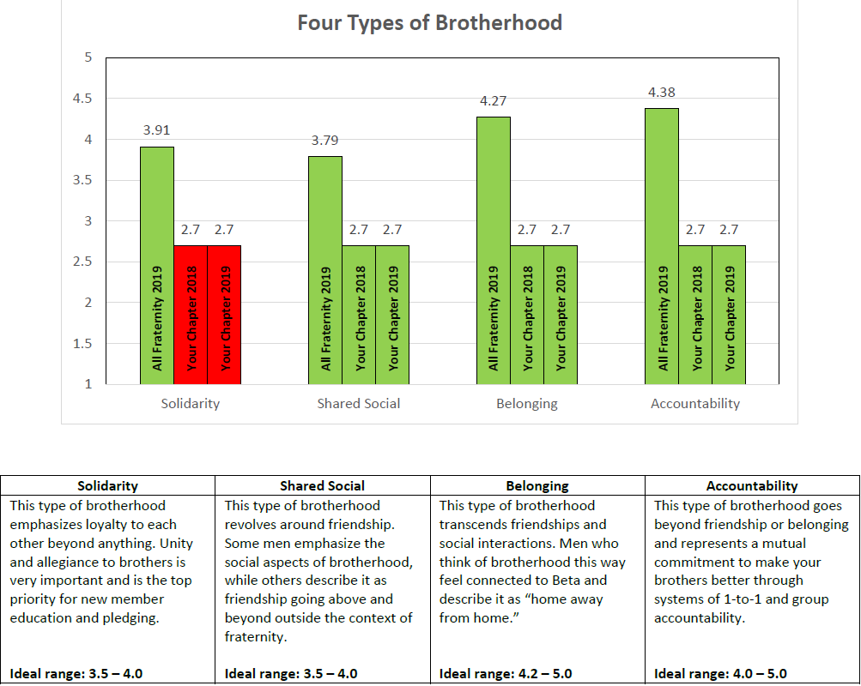
The Chapter Report

Slide 7
4 unique definitions of brotherhood
Brotherhood Based on Solidarity
Brotherhood Based on Shared Social Experiences
Brotherhood Based on Belonging
Brotherhood Based on Accountability

Slide 8
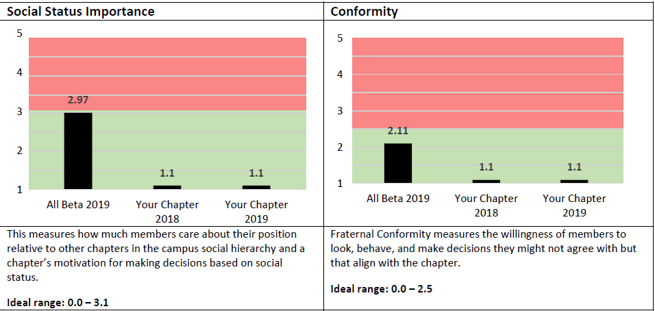
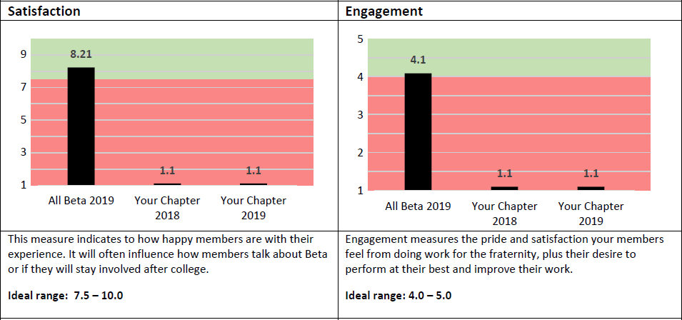
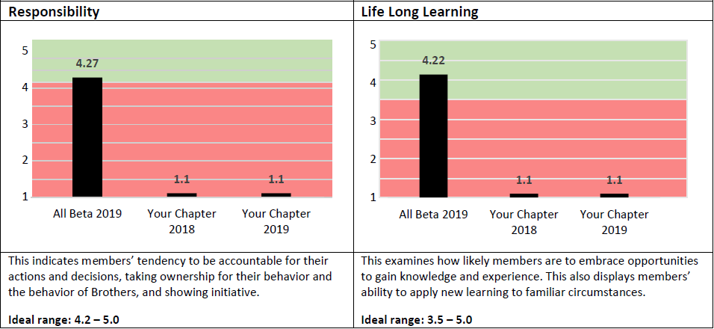
The Chapter Report
Beta Theta Pi’s Organizational Score.
“Ideal” Range
Your Chapter’s 2018 results
Your Chapter’s 2019 results

Slide 9
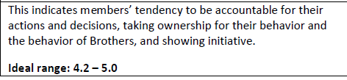
The Chapter Report

Slide 10
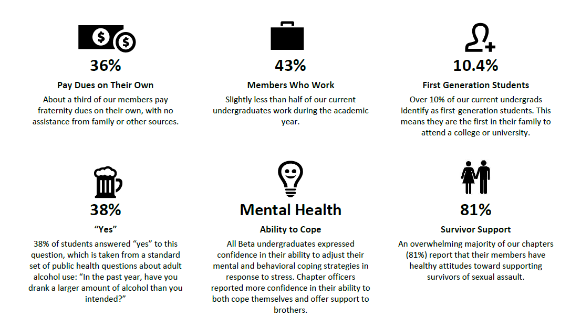
The Chapter Report

Slide 11
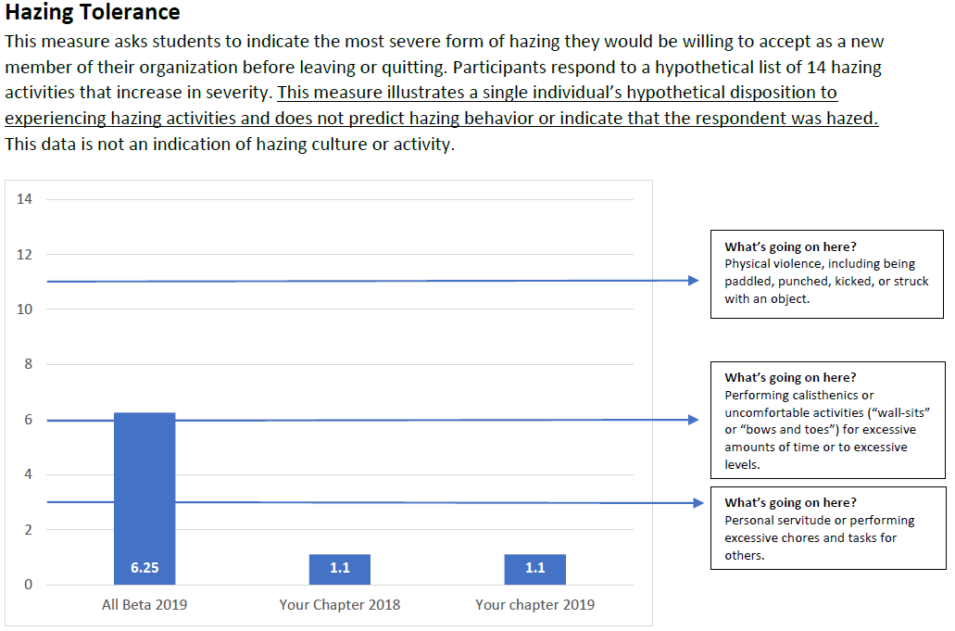
The Chapter Report
This isn’t telling us who was hazed, if someone is hazing, or that our chapter has a hazing problem.
This shows us the attitudes our members have toward hazing and what they would hypothetically be willing to tolerate before leaving our chapter.

Slide 12
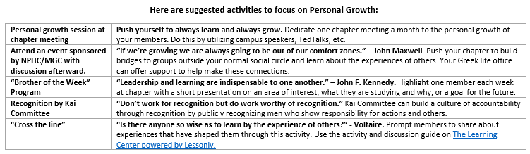
The Chapter Report

Slide 13
Discussion Questions
What are some of your thoughts coming out of your discussions?
What surprised you about our chapter based on the data in the report?
What surprised you about Beta overall based on the data in the report?
What is the area that you think we should focus our efforts on improving working on?

Slide 14
Discussion Questions
Where should the executive team members, and the membership overall look to focus in the coming year.

Slide 15
Discussion Questions
If you have more questions…
Refer to the BBA FAQs document posted on beta.org.
Contact our chapter advisor
Reach out to our Leadership Consultant.
Call the Administrative Office at 800.800.2382

Slide 16
Beta Brotherhood Assessment
Chapter Report Overview
Notes:
..

